Slide 1

Advanced Topics
Sessions, TempData, Cache, Logging, Performance, GDPR
SoftUni Team
Technical Trainers
Software University
http://softuni.bg

Slide 2
Table of Contents
WebHost
Logging
Cache
Sessions
TempData
Work with Files
Areas
Performance
SEO
GDPR

Slide 3
Have a Question?
sli.do #csharp-web

Slide 4



WebHost

Slide 5
WebHost
ASP.NET Core apps configure and launch a host
The host is responsible for app startup and lifetime management
At minimum, the host configures a server and request pipeline
Can also set up logging, dependency injection, and configuration
In ASP.NET Core the host is configured in the app entry point
public class Program
{
public static void Main(string[] args) { CreateWebHostBuilder(args).Build().Run(); }
public static IWebHostBuilder CreateWebHostBuilder(string[] args) =>
WebHost.CreateDefaultBuilder(args)
.UseStartup<Startup>();
}

Slide 6
WebHost
CreateDefaultBuilder() performs several essential tasks
Configures Kestrel servern, loads host and app configuration
Configures logging, IIS integration, sets the content root, etc.
This sets up default config which you can modify:
WebHost.CreateDefaultBuilder(args)
.ConfigureLogging(logging =>
{
logging
.SetMinimumLevel(LogLevel.Warning);
})
...
WebHost.CreateDefaultBuilder(args)
.UseKestrel(options =>
{
options
.Limits.MaxRequestBodySize = 20000000;
})
...

Slide 7

Logging
ILoggerFactory & ILogger

Slide 8
Logging
ASP.NET Core supports a logging API
The API Works with a variety of logging providers
The ASP.NET Core logging infrastructure consists of 3 main components
ILogger – Used by the app to create log messages
ILoggerFactory – Creates instances of ILogger
ILoggerProvider – Controls where log messages are output
An application may have multiple logging providers

Slide 9
Logging
AddConsole()
ILoggerProviders are registered with the ILoggerFactory
ILoggerProviders are used to create loggers that output to a specific destination
ConsoleLoggerProvider
AddFile()
FileLoggerProvider
Injecting an ILogger into a class creates a logger that wraps each of the provided logger types
ILoggerFactory
ConsoleLogger
CreateLogger()
FileLogger
ILogger

Slide 10
Logging
Logging configuration is commonly provided by the app settings
Logging property can have LogLevel
LogLevel specified the minimum level to log
Other properties under Logging can specify logging providers
Sample Logs
appsettings.json
{
"Logging": {
"LogLevel": {
"Default": "Warning"
}
},
...
}
info: TodoApi.Controllers.TodoController[1002]
Getting item 0
warn: TodoApi.Controllers.TodoController[4000]
GetById(0) NOT FOUND

Slide 11






Logging
Logging Levels are not technology-specific
It is important to know the levels and their use
Logging Levels and their description:
Trace – For information, valuable only for debugging
Debug – For information, useful in development and debugging
Information – For tracking the general flow of the application
Warning – For abnormal and unexpected events in the app flow
Error – For errors and exceptions that cannot be handled
Critical – For failures that require immediate attention

Slide 12

Cache
An efficient way to store data

Slide 13
Cache
Cache makes a copy of a piece of data and stores it
Can be extracted much faster than from its original source
Significantly improves application performance
Works best with data that does not change frequently
ASP.NET Core supports several different caches
The simplest cache is based on the IMemoryCache
An in-memory cache stored on the app Server's memory
Can store any type – primitive or complex (object)

Slide 14



Cache
In-memory Cache is configured as a simple service
public void ConfigureServices(IServiceCollection services)
{
services.AddMemoryCache(); // Add the IMemoryCache as a dependency to the DI
services.AddMvc();
}
public class HomeController : Controller
{
private IMemoryCache cache;
public HomeController(IMemoryCache memoryCache)
{
this.cache = memoryCache; // Inject the IMemoryCache through DI
}
...
}

Slide 15
Cache
Here is an example of a cache DateTime value
public IActionResult GetCachedData()
{
DateTime cacheEntry;
if (!this.cache.TryGetValue(CacheKeys.Entry, out cacheEntry)) // Look for cache key.
{
cacheEntry = DateTime.Now; // Key not in cache, so get data.
var cacheEntryOptions = new MemoryCacheEntryOptions() // Set cache options.
.SetSlidingExpiration(TimeSpan.FromSeconds(3)); // Keep in cache for this time.
// Reset time if accessed.
// Save data in cache.
this.cache.Set(CacheKeys.Entry, cacheEntry, cacheEntryOptions);
}
return View("Cache", cacheEntry);
}

Slide 16


Cache
The cached DateTime value remains in the cache
Its value is untouched, from the moment of caching
There are requests within the timeout period
No eviction is done due to memory pressure
<h3>Current Time: @DateTime.Now.TimeOfDay.ToString()</h3>
<h3>Cached Time: @(Model == null ? "No cached entry found" : Model.Value.TimeOfDay.ToString())</h3>

Slide 17
Cache
The framework also supplies you with a convenient Tag Helper
The Cache Tag helper caches content to the internal cache provider
<cache>
Current Time: @DateTime.Now
</cache>
<cache expires-on="@new DateTime(2025,1,29,17,02,0)">
Current Time: @DateTime.Now
</cache>
<cache enabled="true">
Current Time: @DateTime.Now
</cache>
<cache expires-after="@TimeSpan.FromSeconds(120)">
Current Time: @DateTime.Now
</cache>
<cache expires-sliding="@TimeSpan.FromSeconds(60)">
Current Time Inside Cache Tag Helper: @DateTime.Now
</cache>

Slide 18
HTTP Response Cache
There are other types of Cache, like HTTP-based Response Caching
The primary HTTP header for caching is Cache-Control
It is used to specify caching directives
These directives control caching behavior during communication
Response Caching in ASP.NET Core is controlled by a simple middleware
public void ConfigureServices (IServiceCollection services)
{
...
services.AddResponseCaching();
...
}
public void Configure(IApplicationBuilder app, IHostingEnvironment env)
{
...
app.UseResponseCaching();
...
}

Slide 19

HTTP Response Cache
Once enabled, you can configure it:
Manually in Request Handlers
With attributes, on Controller Actions
The convenient built-in ResponseCache attribute is quite useful
The attribute’s properties are used to configure the Caching
[ResponseCache(Duration = 30, Location = ResponseLocation.None, NoStore = true)]
public IActionResult Error()
{
...
}

Slide 20
Sessions
Application State

Slide 21


Sessions
Session state is an ASP.NET Core scenario for storage of client data
Each client has a unique Session ID which the framework stores
Data can be maintained while the client browsers the application
Session data is backed by cache, and is considered ephemeral
The application should continue to function without session data

Slide 22
Sessions
Enabling Session middleware, setting up in-memory session provider
public void ConfigureServices(IServiceCollection services)
{
// services.AddMemoryCache(); // Default in-memory cache – provides IMemoryCache
services.AddDistributedMemoryCache(); // Provides IDistributedCache
services.AddSession(options =>
{ options.IdleTimeout = TimeSpan.FromSeconds(10); // Set a short timeout for easy testing
options.Cookie.HttpOnly = true; // XSS security
});
services.AddMvc();
}
public void Configure(IApplicationBuilder app, IHostingEnvironment env)
{
...
app.UseSession(); // UseSession() Middleware must be called before UseMvc()
app.UseMvc();
}

Slide 23
Sessions
After the Session state is configured, HttpContext.Session is available
ASP.NET Core Sessions store byte array values to ensure serialization
You may need specific approaches in order to store complex data
public IActionResult GetShoppingCart()
{
if (this.HttpContext.Session.Get("Cart") == null)
{
this.HttpContext.Session.SetString("Cart", JsonConvert.SerializeObject(new Cart()));
}
this.ViewData["Cart"] = this.HttpContext.Session.GetString("Cart") == null
? null
: JsonConvert.DeserializeObject(this.HttpContext.Session.GetString("Cart"));
return View();
}

Slide 24
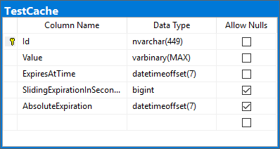
Sessions
We can persist session and cache data in a SQL server database
public void ConfigureServices(IServiceCollection services)
{
services.AddDistributedSqlServerCache(
options =>
{
options.ConnectionString = Configuration.GetConnectionString("DefaultConnection");
options.SchemaName = "dbo";
options.TableName = "TestCache";
});
// services.AddDistributedRedisCache()
services.AddSession();
}
The cache table is created using the sql-cache command
dotnet sql-cache create "Data Source=.;Initial Catalog=db;Integrated Security=True;" dbo TestCache

Slide 25
Sessions
You can implement Session Extension methods to ease your work
public static class SessionExtensions
{
public static void Set<T>(this ISession session, string key, T value)
{
session.SetString(key, JsonConvert.SerializeObject(value));
}
public static T Get<T>(this ISession session, string key)
{
var value = session.GetString(key);
return value == null ? default(T)
: JsonConvert.DeserializeObject<T>(value);
}
}

Slide 26
Temp Data
Store data until it's read

Slide 27


TempData
ASP.NET Core exposes the TempData property in:
Razor Page page models
MVC Controllers
The property stores data until it’s read
Keep() and Peek() methods avoid deletion when data is examined
TempData is:
Particularly used for redirection
When data is required for more than a single request

Slide 28

TempData
TempData is implemented by TempData providers
Using either Cookies or Session State
As of ASP.NET Core 2.0, the default TempData provider is cookie-based
public void ConfigureServices(IServiceCollection services)
{
services.AddMvc().AddSessionStateTempDataProvider();
services.AddSession(...);
}
public void Configure(IApplicationBuilder app, IHostingEnvironment env)
{
...
app.UseSession();
app.UseMvc();
}

Slide 29
TempData
After enabling the TempData, you can access it in:
Your Controller, and Actions
Your Razor Page page model
public IActionResult RedirectToTempData()
{
this.TempData["Previous"] = "/Home/RedirectToTempData";
return this.RedirectToAction("AccessTempData");
}
public IActionResult AccessTempData()
{
this.HttpContext.Response.Headers.Add("Previous", this.TempData["Previous"].ToString());
// Add a HttpHeader ("Previous") with the previous Action URL.
return this.View();
}

Slide 30
TempData
User
Server
Database
POST
SELECT
Redirect 302 Temp Data Cookie
Store Temp Data
RESULT
GET Temp Data Cookie
UPDATE
Get Temp Data
RESULT
OK 200 Clear Temp Data Cookie

Slide 31
Post-redirect-Get
Post-redirect-Get (PRG) is a design pattern in web development
POST requests should be answered with a REDIRECT
The REDIRECT response should trigger a GET request in the client
Post-redirect-Get is designed to reduce duplicate form submissions
These are caused by clients refreshing or navigating back and forth
Post-redirect-Get has a major role in most applications
Duplicate form submissions can be critical in Store applications
Duplicate form submissions may cause undesired Data spam

Slide 32
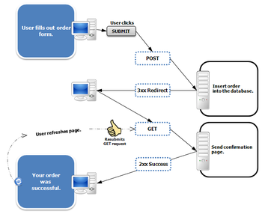
Post-redirect-Get
PRG is a pattern, and easy to implement
[HttpGet]
public IActionResult Create()
{
return View(new ProductModel());
}
[HttpPost]
public IActionResult Create(ProductModel productModel)
{
if (!ModelState.IsValid)
{
return View(productModel);
}
// Do magic with productModel
return RedirectToAction("Details", { id });
}

Slide 33

Work with Files
Uploading and Downloading files

Slide 34

Uploading Files
ASP.NET Core MVC supports File Upload using simple model binding
For larger files, Streaming is used
Multiple-file upload is also supported
<form method="post" enctype="multipart/form-data"
asp-controller="Files" asp-action="Upload">
<input type="file" name="file"> <button type="submit" value="Upload" />
</form>
<form method="post" enctype="multipart/form-data" asp-controller="Files" asp-action="Upload">
<input type="file" name="files" multiple > <button type="submit" value="Upload" />
</form>

Slide 35


Uploading Files
When uploading files using model binding, your action should accept:
IFormFile (for single file) or IEnumerable<IFormFile> (or List<IFormFile>)
[HttpPost("Upload")]
public async Task<IActionResult> Upload(List<IFormFile> files)
{
var filePath = Path.GetTempFileName(); // Full path to file in temp location
foreach (var formFile in files.Where(f => f.Length > 0))
{
using (var stream = new FileStream(filePath, FileMode.Create))
{
await formFile.CopyToAsync(stream);
}
} // Copy files to FileSystem using Streams
return Ok(new { count = files.Count, files.Sum(f => f.Length), filePath});
}

Slide 36




Downloading Files
ASP.NET Core abstracts file system access through File Providers
File Providers are used throughout the ASP.NET Core framework
Examples of where ASP.NET Core uses File Providers internally
IHostingEnvironment exposes the app’s content root and web root
Static File Middleware uses File Providers to locate static files
Razor uses File Providers to locate pages and views

Slide 37
Downloading Files
To access physical files, you have to use PhysicalFileProvider
You’ll have to initialize it with your server physical files folder path
Then you can extract information about the File
public IActionResult Download(string fileName)
{
// Construct the path to the physical files folder
string filePath = this.env.ContentRootPath + this.config["FileSystem:FilesFolderPath"];
IFileProvider provider = new PhysicalFileProvider(filePath); // Initialize the Provider
IFileInfo fileInfo = provider.GetFileInfo(fileName); // Extract the FileInfo
var readStream = fileInfo.CreateReadStream(); // Extact the Stream
var mimeType = "application/octet-stream"; // Set a mimeType
return File(readStream, mimeType, fileName); // Return FileResult
} // NOTE: There is no check if the File exists. This action may result in an error

Slide 38

Areas

Slide 39
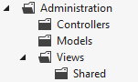
Areas
Some applications can have a large number of components
We can partition Web applications into smaller units (Areas)
An Area is effectively an MVC structure inside an application
Example: large e-commerce application
Store, users, blog, forum, administration
To use areas you should change the default route template:
routes.MapRoute(
name: "areas",
template: "{area:exists}/{controller=Home}/{action=Index}/{id?}"
);

Slide 40
Performance

Slide 41


Performance
Performance is an important topic in Web app development
Slow-loading discomforts your clients and drives them elsewhere
There is no magic functionality which optimizes your app
There are many tips, though, on how to speed up your app

Slide 42


Performance Tips
Measure everything (Application Insights, dotTrace)
Gather diagnostics for your application
Localize which are the slow components of your application
Analyze what slows down these components
Order and prioritize the most malicious slow-pokes
Pick the low-hanging fruit first
Once you've determined the slowest component, prioritize it

Slide 43

Performance Tips
Enable Compression
HTTP Protocol is not particularly efficient
You can enable Response Compression to increase app efficiency
ConfigureServices: services.AddResponseCompression();
Configure: app.UseResponseCompression();
Reduce HTTP Requests
HTTP Communication is quite slow
Reduce amount of HTTP Requests needed for each functionality
Use sprites for images and fonts instead of images

Slide 44
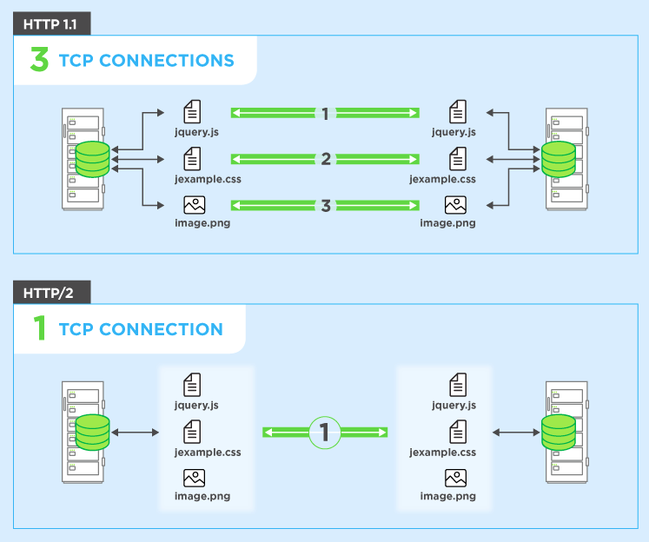
Performance Tips
HTTP/2 over SSL (enabled by default)
Binary protocol, Compression of headers
Request multiplexing, HTTP 1.1 compatible
Minify your files (bundleconfig.json)
Compression is a great tool
Your third-party resources are unnecessarily slowing your app
You can minify them in order to reduce the data traffic

Slide 45
Performance Tips
Load CSS First
CSS Content must be loaded first, preferably in the head section
Browsers tend to do unnecessary actions when rendering pages
Load JS Last
Pages need to be rendered as quickly as possible
JavaScript is not particularly needed for the rendering of pages
Of course, this is only applicable to non-heavy JavaScript sites

Slide 46
Performance Tips
Cache your pages
There is a lot of static, unchangeable content on web app pages
The process of its slow retrieval does not need to be repeated
Content Delivery Network (CDN)
CDN outsources a bit of work from your application
There are plenty of CDNs closely-located to your clients
CDNs are a preferred resource in Production Environment

Slide 47
SEO
Search Engine Optimization

Slide 48

Search Engine Optimization (SEO)
Search Engine Optimization is very important in web apps
Common users tend to use Google/Bing to look for services
There are ways to boost your place in the results of SEs
There are several simple tips you can follow:
Unique content, external links from trustworthy sites
Make your application crawlable and fast
Make your URLs meaningful
Unique and relevant title and description with keywords

Slide 49

GDPR

Slide 50

GDPR
General Data Protection Regulation (GDPR) is a regulation in EU law
Addresses data protection and privacy of individuals within the EU
It also addresses export of personal data outside of the EU
GDPR aims to:
Provide individuals with more control over their personal data
Simplify the regulatory environment for international businesses
ASP.NET Core provides APIs to help meet some GDPR requirements
There is also a sample app in GitHub here

Slide 51
GDPR
There are several individual rights you must provide your clients
Right to be informed – inform your clients how you use their personal data
Right of access – if a client requests their data, you must provide it
Right to rectification – allow clients to correct inaccurate personal data
Right to erasure – provide clients with the ability to erase their data
Right to restrict processing – allow clients to block processing of their data
Right to portability – allow clients to obtain and reuse their data
Right to object – allow clients to object to the use of their personal data
Rights related to automatic decision making, including profiling

Slide 52

Summary
WebHost
Logging
Cache, Sessions, TempData
Work with Files
Areas
Performance
SEO
GDPR
…
…
…

Slide 53
https://softuni.bg/trainings/courses

Slide 54












SoftUni Diamond Partners

Slide 55




SoftUni Organizational Partners

Slide 56




Trainings @ Software University (SoftUni)
Software University – High-Quality Education and Employment Opportunities
softuni.bg
Software University Foundation
http://softuni.foundation/
Software University @ Facebook
facebook.com/SoftwareUniversity
Software University Forums
forum.softuni.bg

Slide 57

License
This course (slides, examples, demos, videos, homework, etc.) is licensed under the "Creative Commons Attribution-NonCommercial-ShareAlike 4.0 International" license

